Slide 1

BCSE102L - Structured and Object-Oriented Programming STORAGE CLASSES, SCOPE, VISIBILITY LIFETIME OF VARIABLES

Slide 2
Scope and Lifetime of a Variable in C Language
Scope determines the region in a C program where a variable is available to use.
Visibility of a variable is related to the accessibility of a variable in a particular scope of the program
Lifetime of a variable is for how much time a variable remains in the system's memory.

Slide 3
Scope of a variable
Scope is defined as the availability of a variable inside a program, scope is basically the region of code in which a variable is available to use.
There are four types of scope:
file scope(Global Scope)
block scope,
function scope and
prototype scope.

Slide 4
Global vs Local Scope
Global scope :
When variable is defined outside all functions.
It is then available to all the functions of the program and all the blocks program contains.
Local scope :
When variable is defined inside a function or a block, then it is locally accessible within the block and hence it is a local variable.

Slide 5
Global vs Local Scope
int global = 100; // global variable declared
void main()
{
int local = 10; // local variable declared
printf("Global variable is %d",global);
printf("Local variable is %d",local);
func1();
}
void func1()
{
printf("Global inside func1 is %d",global);
}

Slide 6
FILE SCOPE(GLOBAL SCOPE)
File scope of variables in C is defined as having the availability of the variable throughout the file/program.
It means that the variable has a global scope, and it is available all around for every function and every block in the program.

Slide 7
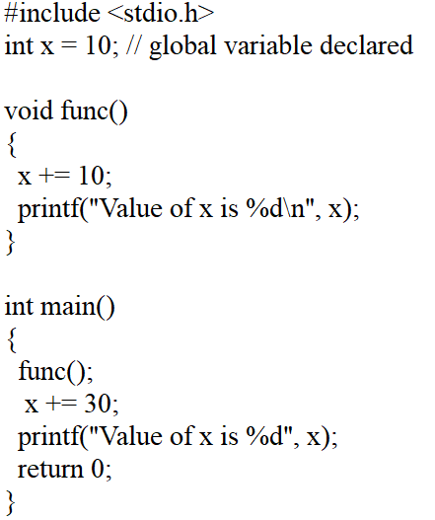
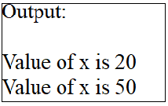

Slide 8
BLOCK SCOPE
Block scope of variables in C is defined as when the variable has a limited scope, and the memory occupied by the variable will be deleted once the execution of the block ends.
The variable is not accessible or available outside the block.
A block of code can be defined in curly braces {code_block}.

Slide 9
// C program to illustrate the scope of a variable
#include <stdio.h>
int main()
{
// Scope of this variable is within main() function
// only.
int var = 34;
printf("%d", var);
return 0;
}
// function where we try to access the var defined in main()
void func()
{ printf("%d", var);
}

Slide 10
Function Scope
Function scope of variables in C begins with the left curly brace { and ends with a closing right curly brace }.
A variable declared inside a function has a function scope.
It has been allocated memory when the function is called, and once the function returns something, the function execution ends and with it, the variable goes out of scope, i.e. it gets deleted from the memory.

Slide 11
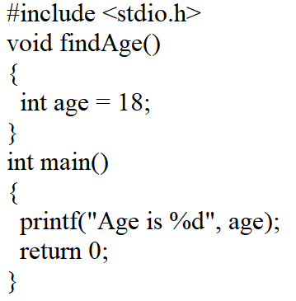


Slide 12
Function Prototype Scope
Function prototype scope of variables in C are declared in some function as its parameters.
If the declarator or type specifier that declares the identifier appears within the list of parameter declarations in a function prototype (not part of a function definition), the identifier has function prototype scope, which terminates at the end of the function declarator.
So, scope of an identifier begins at the end of the identifier's declaration and ends at the end of the function declaration.
The identifier in the function prototype and the corresponding identifier in the function definition need not be identical but can be perhaps to improve readability.

Slide 13
The scope of identifier "lho" begins at the comma and ends at the closing parenthesis
#include <stdio.h>
/* function prototype (not part of a function definition) */
int simple_add (int lho, int rho);
int lho; /* no conflict with "lho" in function prototype */
int main(void)
{
printf("%d\n", simple_add(1,2));
return 0;
}
int simple_add (int lho, int rho)
{
return (lho+rho);
}

Slide 14
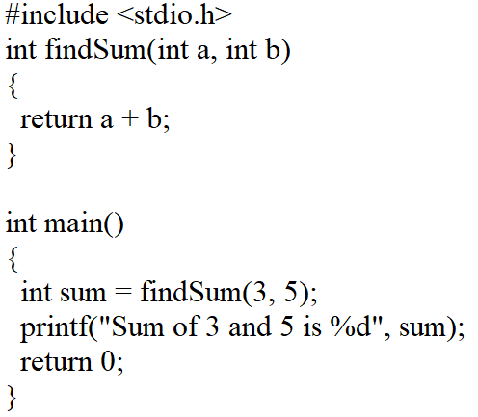
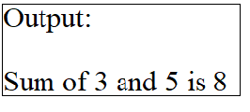

Slide 15
Lifetime of a variable
Lifetime of a variable is defined as for how much time period a variable occupies a valid space in the system's memory
Once the variable is out of scope its lifetime ends.
Lifetime is also known as the range/extent of a variable.
Types of lifetime
static lifetime
automatic lifetime
dynamic lifetime.

Slide 16
Static Lifetime
The static variable is defined using the static keyword.
Its scope depends on the area of its declaration.
If a static variable is defined within a function, it is a local variable.
If declared outside the function, its scope is global.
A static variable statically allocated memory to the variable and its lifetime throughout the program.
It holds its value whenever a program is called.
The default value of the static variable is 0.
Example :
static int count = 0;

Slide 17
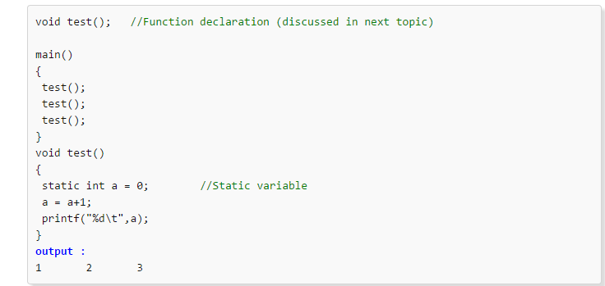
Static in C

Slide 18
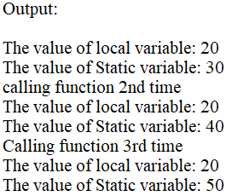
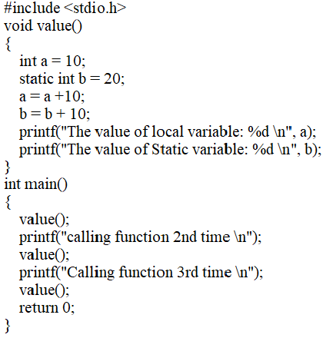

Slide 19
Properties of static variable
A static variable is destroyed only after the whole program gets executed. It does not depend on the scope of the function in which it is declared.
A static variable has a property to retain its value from its previous scope. This means that its value does not get re-initialized if the function in which it is declared gets called multiple times.
If no value is assigned to a static variable, by default, it takes the value 0.
The memory of the static variable is available throughout the program but its scope is only restricted to the block where it is declared.

Slide 20
Automatic Lifetime
All variables declared in C programming are automatic by default.
You can use the auto keyword to declare the automatic variable.
An automatic variable is a local variable whose lifetime is within the code only.
Its default value is garbage.
Example :
{ // block of code
int auto_lifetime_var = 0;
}

Slide 21
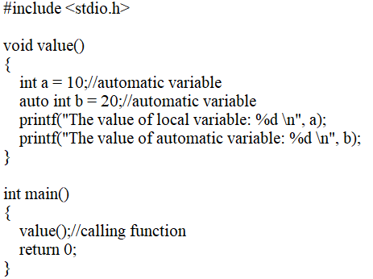


Slide 22
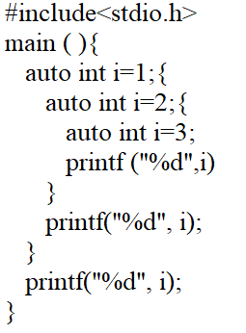


Slide 23
Dynamic Lifetime
Objects/Variables which are made during the run-time of a C program using the Dynamic Memory Allocation concept using the malloc(), calloc() functions in C are stored in the memory until they are explicitly removed from the memory using the free() function in C or delete operator in C++ and these variables are said to have a dynamic lifetime.
These variables are stored in the heap section of our system's memory, which is also known as the dynamic memory.
Example :
int *ptr = (int *)malloc(sizeof(int));

Slide 24
// C program to create dynamic array using malloc() function
#include <stdio.h>
#include <stdlib.h>
int main()
{
// address of the block created hold by this pointer
int* ptr;
int size;
// Size of the array
printf("Enter size of elements:");
scanf("%d", &size);
// Memory allocates dynamically using malloc()
ptr = (int*)malloc(size * sizeof(int)); // Checking for memory allocation
if (ptr == NULL) {
printf("Memory not allocated.\n");
}
else {
// Memory allocated
printf("Memory successfully allocated using " "malloc.\n");
// Get the elements of the array
for (int j = 0; j < size; ++j) {
ptr[j] = j + 1;
}

Slide 25
// Print the elements of the array
printf("The elements of the array are: ");
for (int k = 0; k < size; ++k) {
printf("%d, ", ptr[k]);
}
}
return 0;
}

Slide 26
Explanation :
Variables num2 and j as well as function parameters a and b are local to the function func1() and have function scope and prototype scope respectively.
Variables declared in function func2() and main() function are not visible in func1().
The variables num1 and num2 are global variables having file scope.
num1 is visible in func1() but num2 is hidden/invisible by the local declaration of num2 i.e. int num2.

Slide 27
Register Variable
Register variable uses register keyword before its definitions and it is stored in the CPU register.
It is a local variable.
These variables have fast processing.
The default value of the register variable is garbage.
Its lifetime is till the end of the function.
Example:
register int a = 30;

Slide 28
Point to be noted
Not every type of variable can be stored in a CPU register.
For example, if the microprocessor has 16-bit registers then they cannot hold a float value or a double value, which require 4 and 8 bytes respectively.
However, if you use the register storage class for a float or a double variable, you won’t get any error messages.
All that would happen is the compiler would treat the variables to be of auto storage class.

Slide 29
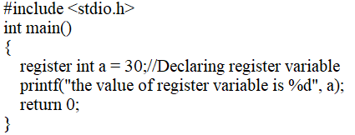


Slide 30
Extern Variable
The extern variables use the extern keyword before the variable definition.
This enhances the variable visibility, and the variable can be used in different C files.
It is a global variable.
It is not necessary to initialize the variable at the time of its declaration.
Default value is 0.
Its lifetime is the entire program.
Syntax:
extern data_type variable_name;
Example:
extern int a;

Slide 31
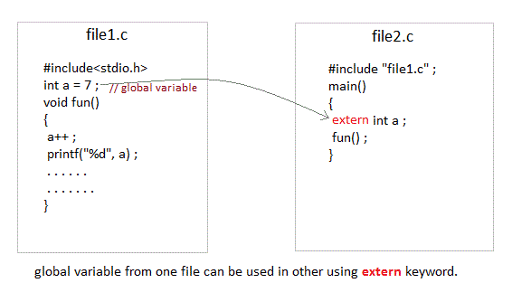
Extern in C

Slide 32
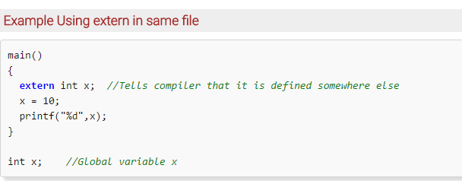
Extern in C

Slide 33
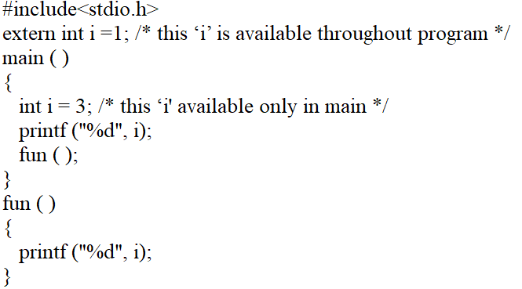
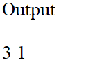

Slide 34
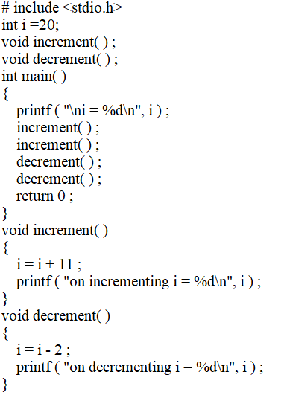
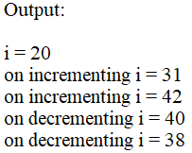

Slide 35
Declaration and Definition of Variables in C
Declaration – Information to compiler about the variable
Definition – Memory is allocated for the variable according to type
For all storage classes declaration and definition are same except for extern
When a keyword extern precedes, its only a declaration and the compiler waits for definition without raising error

Slide 36
Constant Variable
The constant variables are special variables in C whose value does not change throughout the program after initialization.
It is a read-only variable in C.
Initializing a constant variable at the time of variable declaration is mandatory.
It uses the “const” keyword before its definition.

Slide 37
Constant Variable
Syntax:
const data_type variable_name = initial_value;
We can initialize other variables anytime and anywhere in the program and can also change their value.
But constant variables have a fixed value, you cannot change their value after their initialization.
If you try to change the value of a constant variable, the program will generate errors.

Slide 38
Output: Error
#include <stdio.h>
int main()
{
int a = 30;
// declaring constant variable
const int b =10;
// Changing value of constant variable
b = 20;
return 0;
}

Slide 39
Storage Classes in C
Four Storage Classes, classified based on life and scope of access:
Storage Class | Life | Scope
Auto | Created when a function is called and destroyed automatically when function exits Default – int n; | Can be accessed only within the function where it is declared
Register | Similar to Auto but stored in register, a faster memory. Number of register is limited. Therefore automatically converted to auto if necessary register int number; | Similar to Auto

Slide 40
Storage Classes in C
Storage Class | Life | Scope
Static | Created when a function is called Mandatory for programmer to initialize Lives till the program executes static int n =10; | Accessible only inside the function where it is defined
Extern | Created when the program execution starts extern int n; | Global variables that can be shared across files

Slide 41
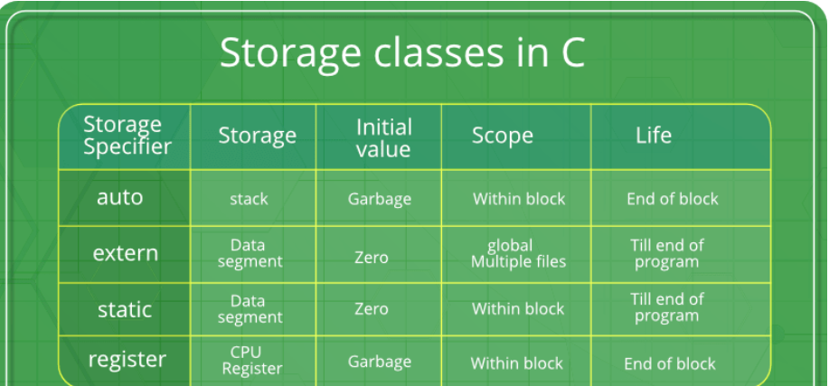


Slide 42


